Slide 1
DOCKER 實作練習
資工三 110410502 莊富涵

Slide 2
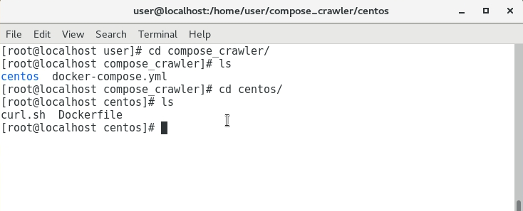
DOCKER 爬蟲範例練習
Compose_crawler
Centos資料夾
curl.sh
Dockerfile
docker-compose.yml

Slide 3
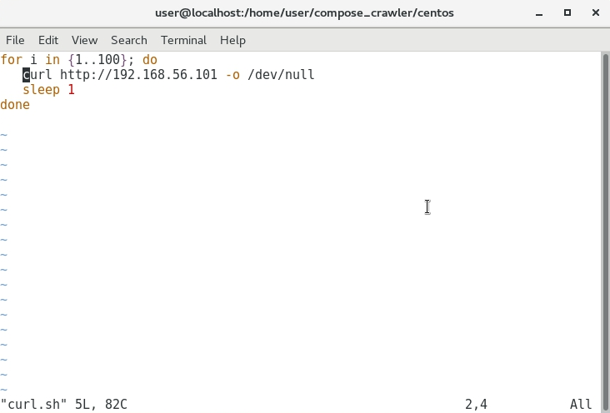
curl.sh

Slide 4
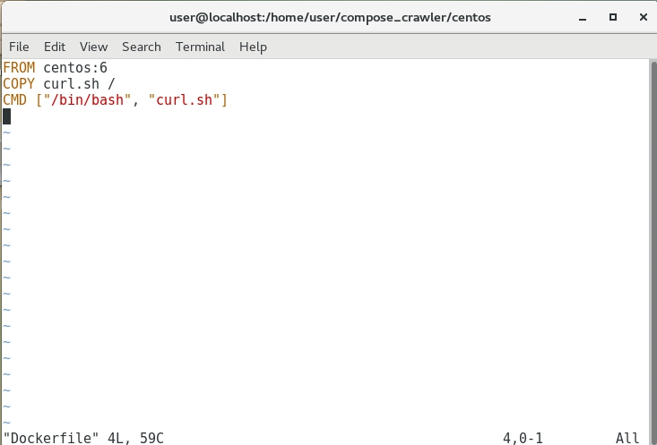
Dockerfile

Slide 5
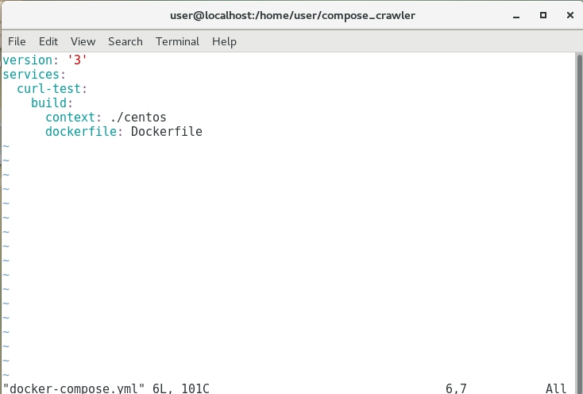
docker-compose.yml

Slide 6
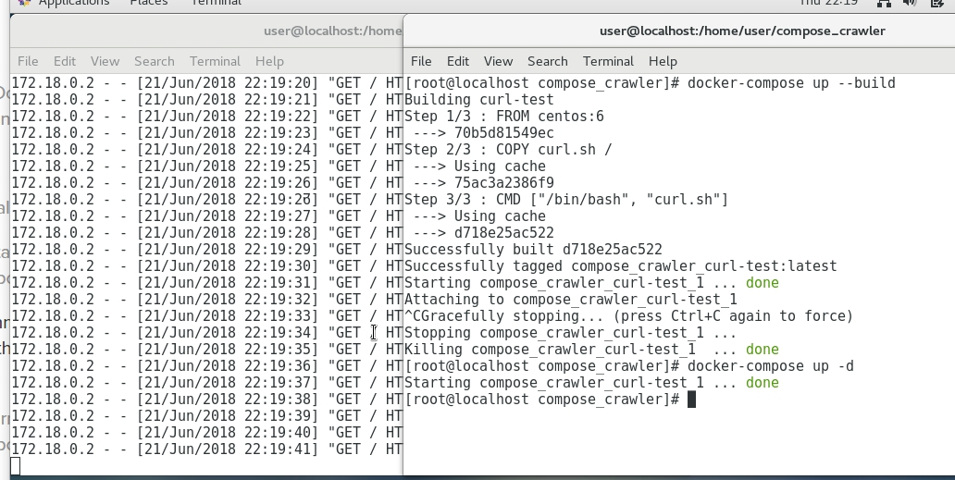

Slide 7
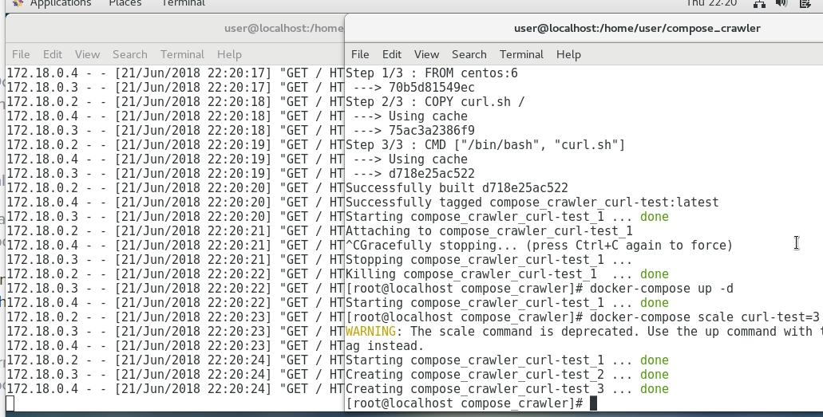

Slide 8
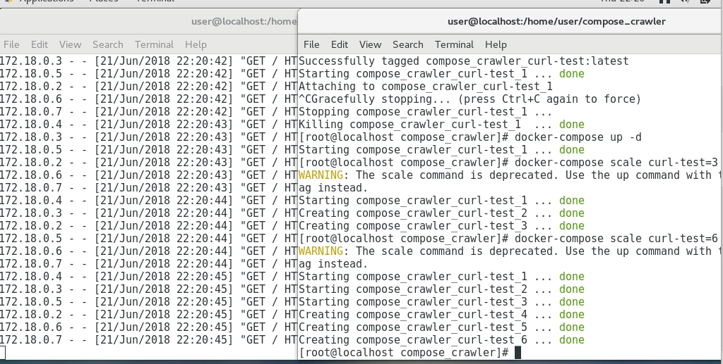

Slide 9
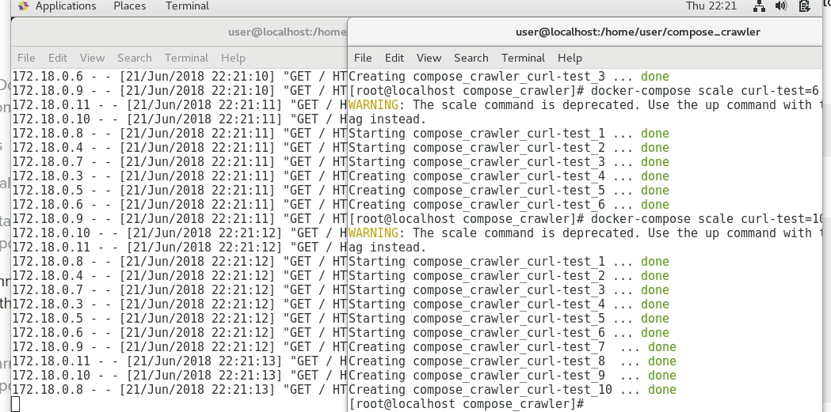

Slide 10
